Slide 1
December 2014
Smart Irrigation
Team iSlugs:
Alex Mitchell, Evan Hughes, Alesandra Roger, Ian Hamilton, Rashad Kayed, Yugraj Singh
IDEASS Smart Irrigation Project:
Kevin Bell: IDEASS advisor
Tamara Ball: associate IDEASS advisor

Slide 2
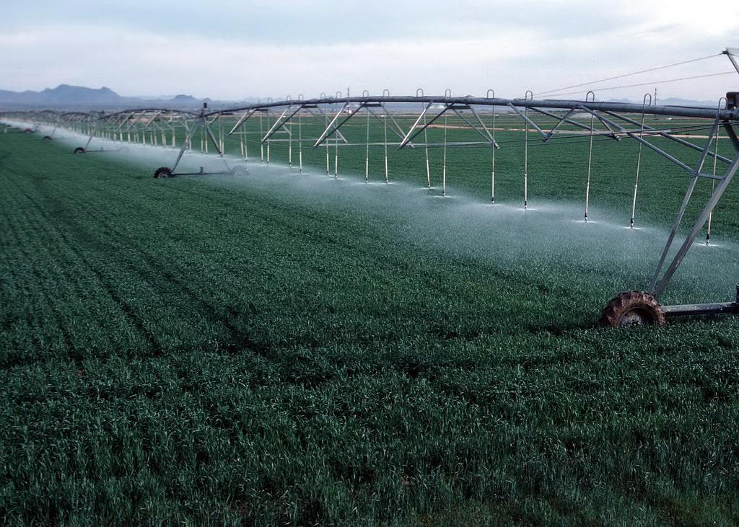
Problem/Application:
Goal: Design a system architecture that interfaces with an autonomous microcontroller and wireless chip allowing farmers to accurately water their plants based off of the soil moisture levels collected by a water sensor in the ground.
Technologies Used:
Arduino Uno
XBee Chip
Humidity Sensor
Project Management Techniques Used:
Tracking estimates of project duration
Creating and delegating tasks
Project Deliverables
Technical Process Plan
Test Planning

Slide 3
Challenges & Accomplishments
Biggest Challenges:
Programming the XBee chip and interfacing it with Arduino.
Finding a water sensor with comprehensive documentation.
B. Biggest Accomplishments:
Figuring out how to package our data object was a small hurdle because our object instances were not being freed from memory. Redesigning the way we filled our objects allowed the project to continue.
The Arduino Uno proved to be an easy enough microcontroller to work with which set us up for success.
Creating a working, flexible architecture that reads in data and stores the data so soil moisture levels are available to trigger watering of plants.

Slide 4
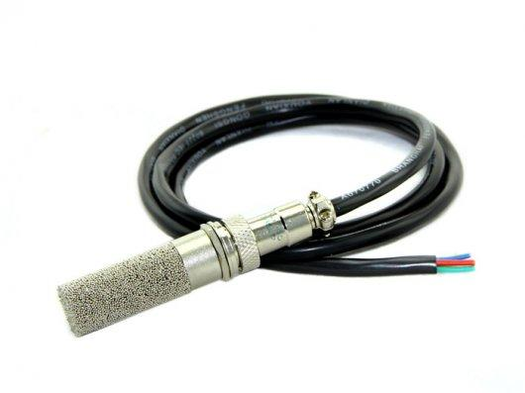
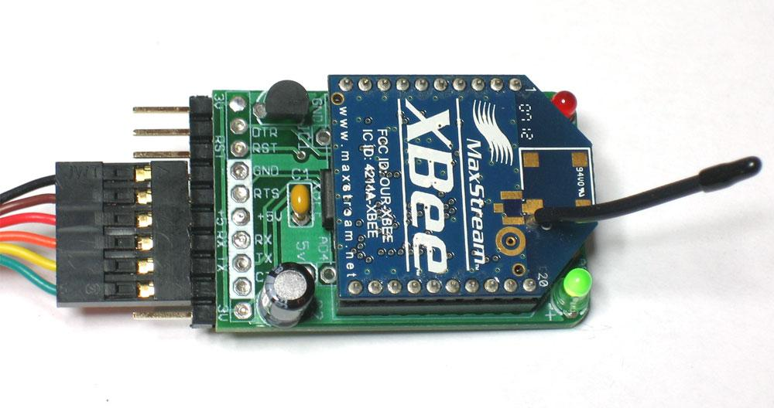
What We Did and Didn’t Enjoy
Enjoyed:
Learning about and working with hardware we had never dealt with
(XBee chip and Moisture Sensor).
Designing a system architecture using arduino libraries.
Working with the group and pairing on some of the coding.
Didn’t enjoy:
All the reports we were required to do.
Lack of timely correspondence with our advisor.
Having three Sprints instead of four.

Slide 5

Lessons Learned
What worked:
Having a plan before working.
Strong communication between team members.
Having hardware documentation to guide in the process of building out system.
What didn’t work:
Showing up late to meetings.
Coding without any sense of design.
Staying on target during iterations.

Slide 6
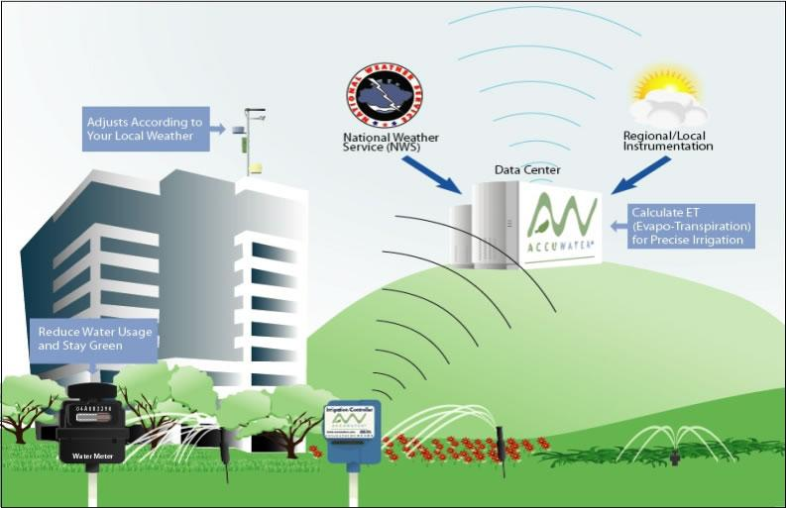
Thanks!
We hope we gave you something cool to think about!

